Slide 1
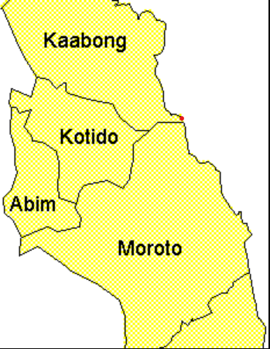
FOOD SECURITY IN KARAMOJA
INTERACTIVE DASHBOARD USING TABLEAU
DATE: 28TH AUGUST 2025
By GROUP 4: Sharahbil,MICHELLE,SHALEEN,IAN,GERALD,HENRY

Slide 2
INTRODUCTION
Food security is a critical issue in Karamoja
Project Goal: Use data to monitor crop yields, production, and population demand
Tools: Python (data cleaning and analysis) Tableau (Visualization)

Slide 3
DATA SOURCES
Yield dataset (yield.csv)
Crop: maize and sorghum
District, Subcounty, Yield(Kg/Ha), Area(Ha), Production
Population dataset (population.csv)
District, Subcounty and Population
Join Key: District+ Subcounty

Slide 4
DATA CLEANING AND ANALYSIS
Missing values handled
Duplicates dropped
Per capita production calculated
Statistical test (t-test): Compared sorghum vs maize yields

Slide 5
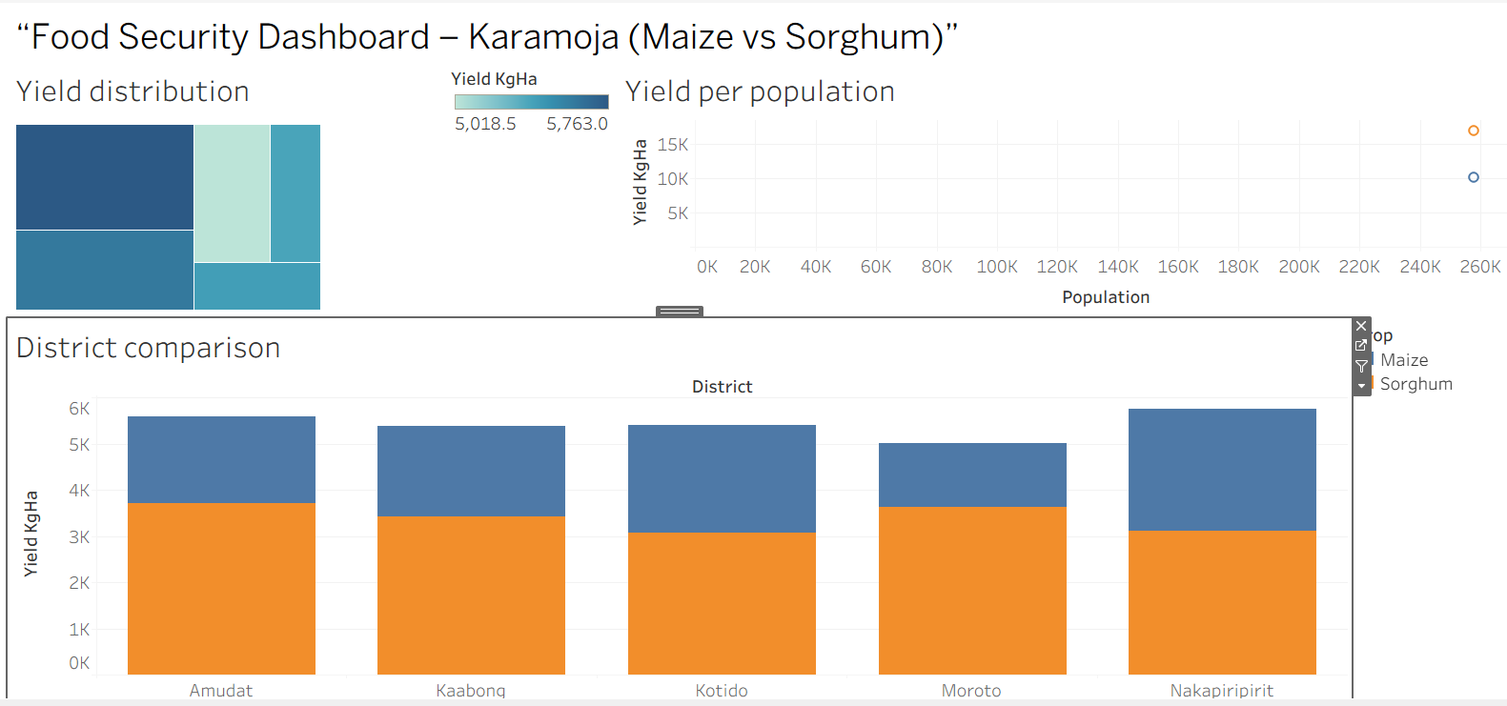
Dashboard overview

Slide 6
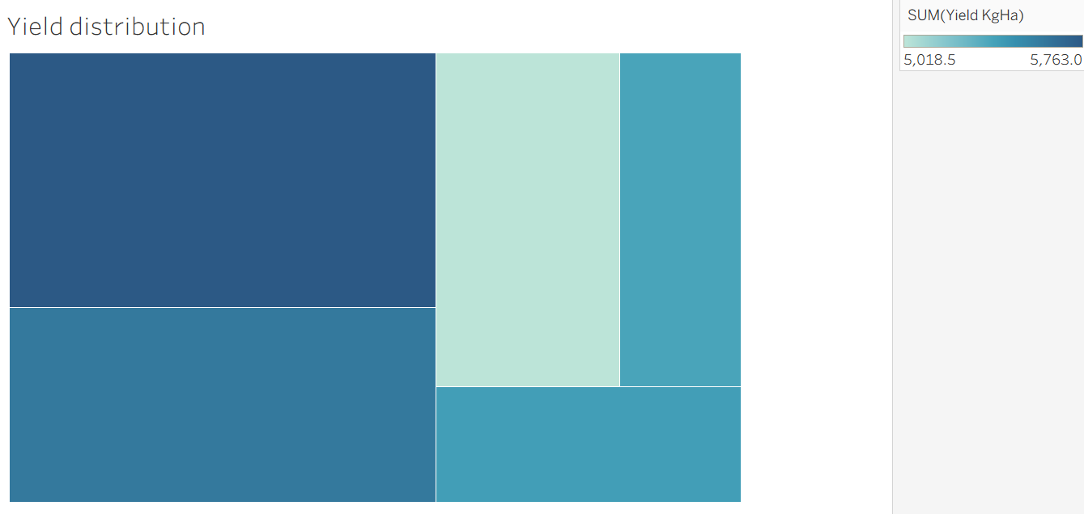
MAP OF YIELDS
Higher yields in District- Nakapiripirit
Lower yields in District- Moroto

Slide 7
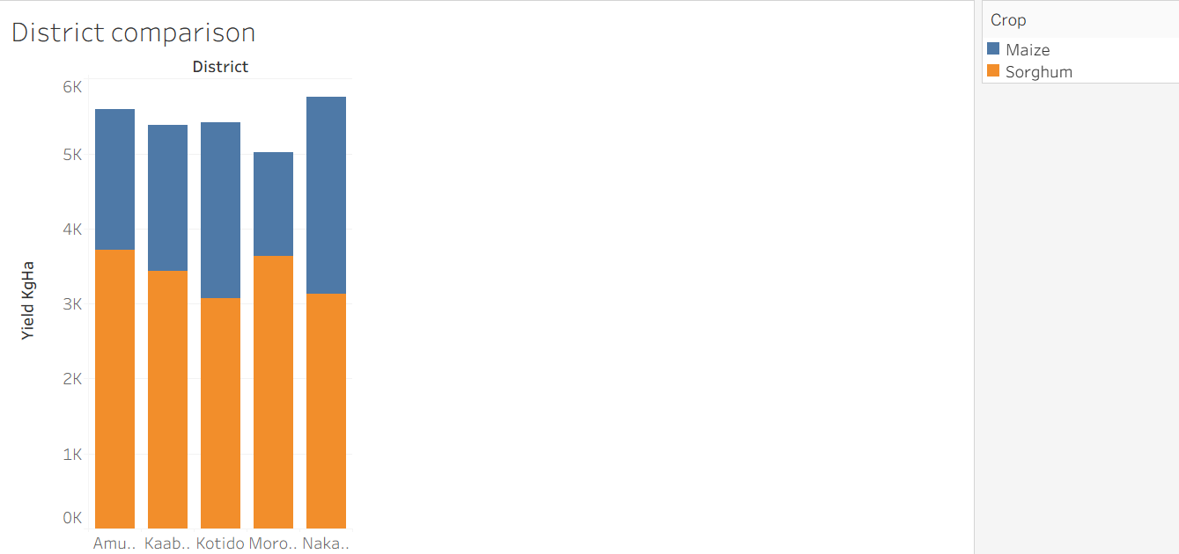
Bar chart of yields
There is higher yield in sorghum in every district than maize
The district with the highest yield in sorghum is Amudat
The district with the highest yield in maize is Nakapiripirit

Slide 8
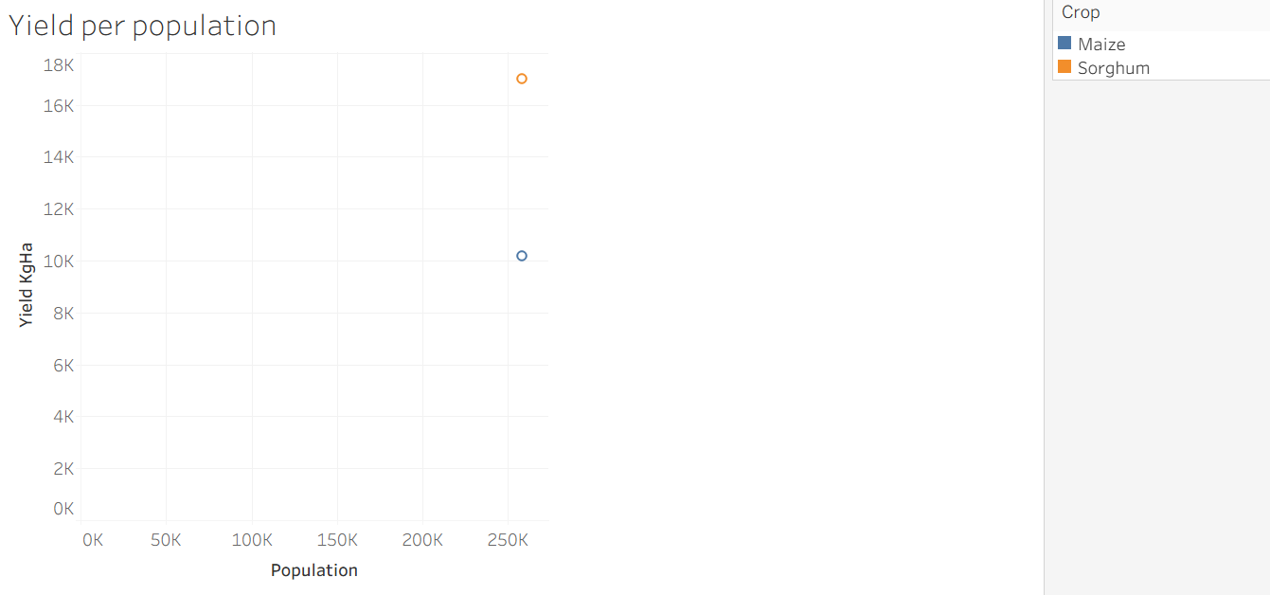
Scatter plot
Sorghum has higher yield(KgHa) than maize

Slide 9
INSIGHTS AND DISCUSSIONS
Some district produce enough; others fall behind.
Sorghum and maize yields are statistically similar.
Larger population often face production shortfalls.

Slide 10
RECOMMENDATIONS AND FINDINGS
Sorghum vs Maize
Sorghum generally performs better across most districts.
The t-test shows whether this difference is statistically significant.
High-Risk Districts
Districts with high population but low productivity per capita (e.g., Kotido, Moroto) are at higher food security risk.
Opportunities
Districts with large land but low yield should be targeted for agricultural support.
Areas with good sorghum yields could be prioritized for scaling sorghum production.

Slide 11
conclusions
Data-driven monitoring helps improve food security.
Tableau dashboard provides clear, interactive insights.

Slide 12

THANK YOU

